Slide 1
Risk Benefit Analysis and Reducing Risk
Vivek Garg
CSVTU Bhilai

Slide 2
Risk Benefit Analysis
A risk-benefit analysis is a comparison between the risks of a situation and its benefits. The goal is to figure out whether the risk or benefit is most significant. It's used often in medicine, because every medical procedure has risks associated with it, and some procedures that could be beneficial actually turn out to statistically cause more harm than good. That's how medical researchers figure out whether certain procedures are worth doing and what types of people will benefit.
But risk-benefit analyses are useful for everyone. Most of us make our decisions fairly subconsciously. By actually thinking about the risks and benefits, we can make better decisions about our lives. To complete a risk-benefit analysis, there are four main pieces of information you need:
What are the risks?
How likely are the risks to happen?
What are the benefits?
How likely are the benefits to happen?
Let's go through an example of how this works.

Slide 3
Risk Benefit Analysis
Eg - Let's say that there's a new disease called horribilitis. It's really awful, painful, and causes people to eventually die, even at a young age. There is a test that can see if you have horribilitis before you even have symptoms. And we want to know, should we screen the whole population to find out who has it nice and early?
To figure that out, we have to do a risk-benefit analysis. First of all, what are the benefits of doing the screening? Well, that should be pretty obvious: We will find out who has the disease and be able to treat it. But before we can really see how great the benefit will be, we need more information. We need to know two main things: How successful is our treatment of it? And will finding it early make treatment more successful? Sometimes, you find that research shows that early treatment makes little to no difference. But let's assume that we have some great treatments that can help, and treating the disease early will make people much less likely to die.

Slide 4
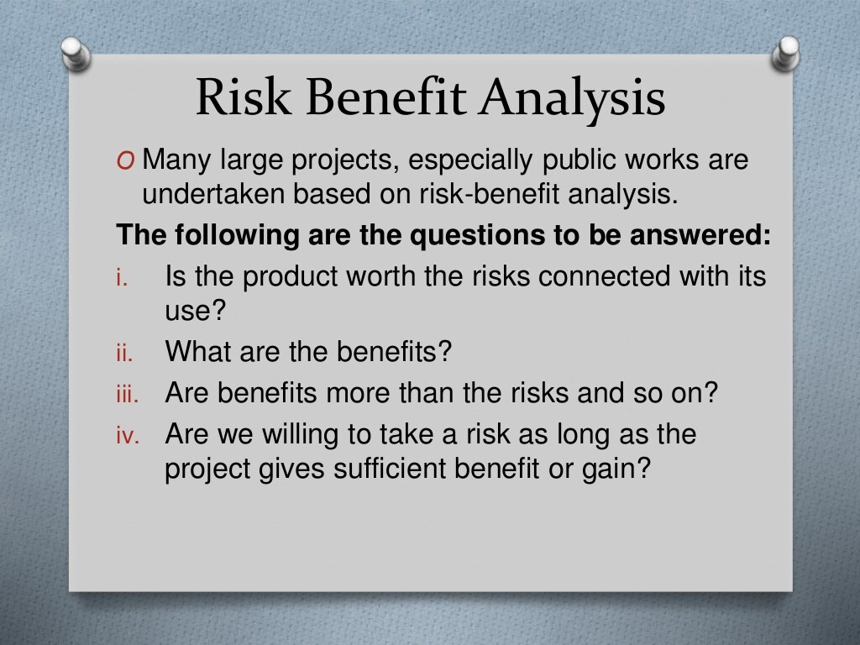

Slide 5
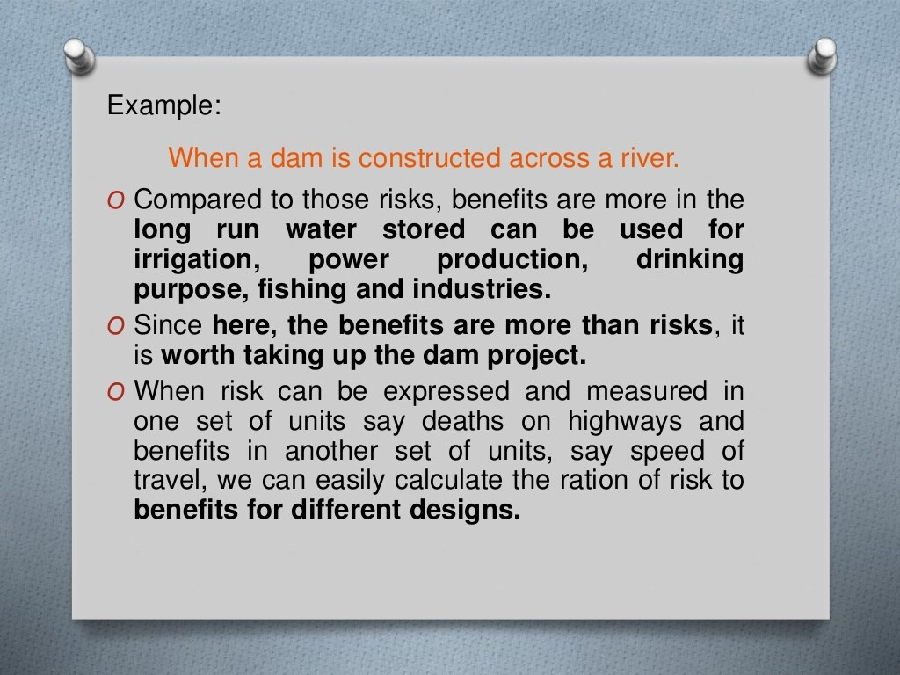

Slide 6
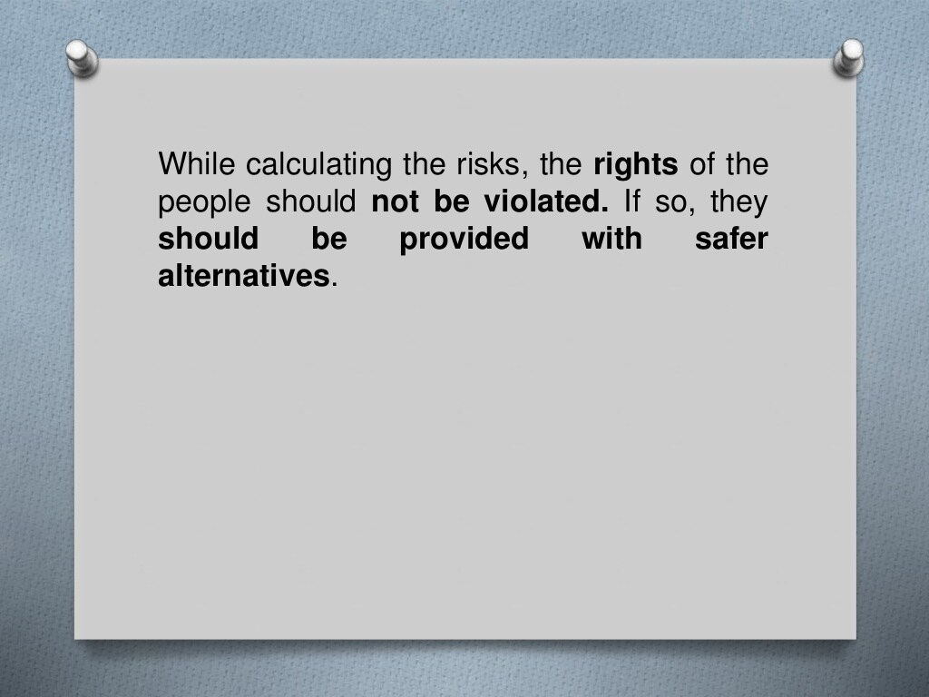

Slide 7
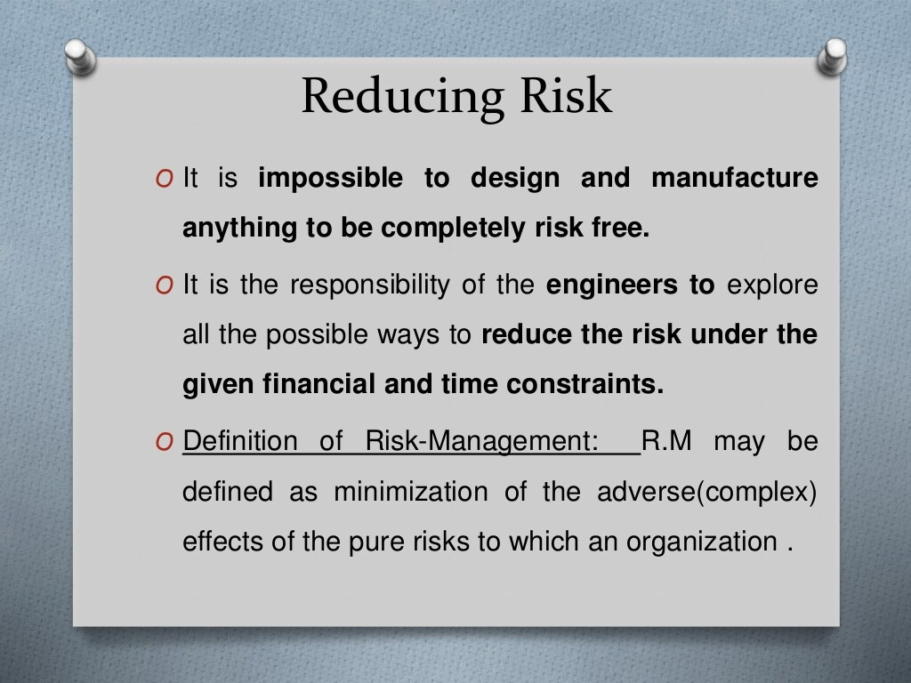

Slide 8
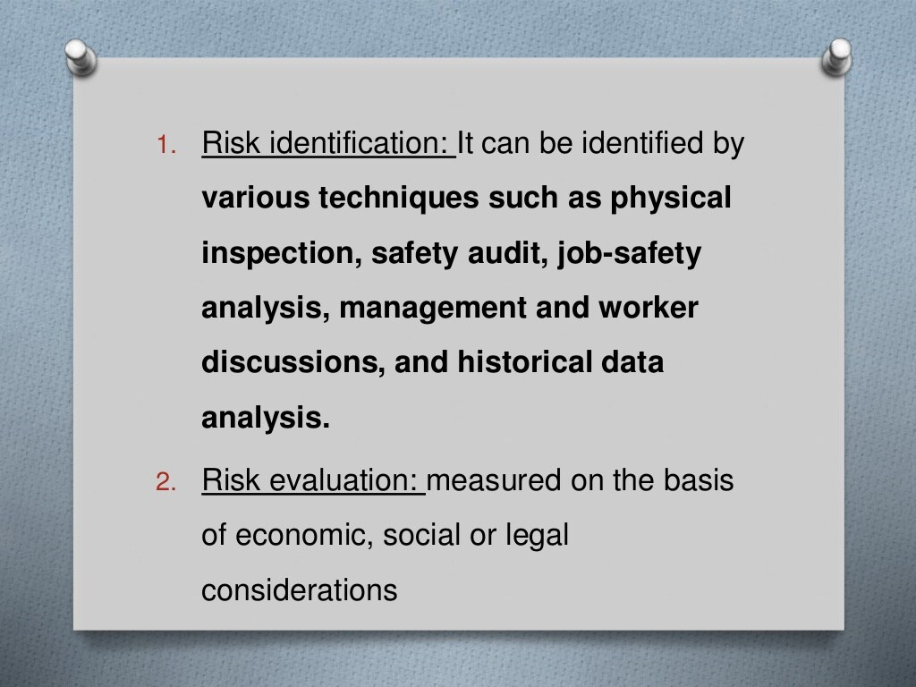

Slide 9
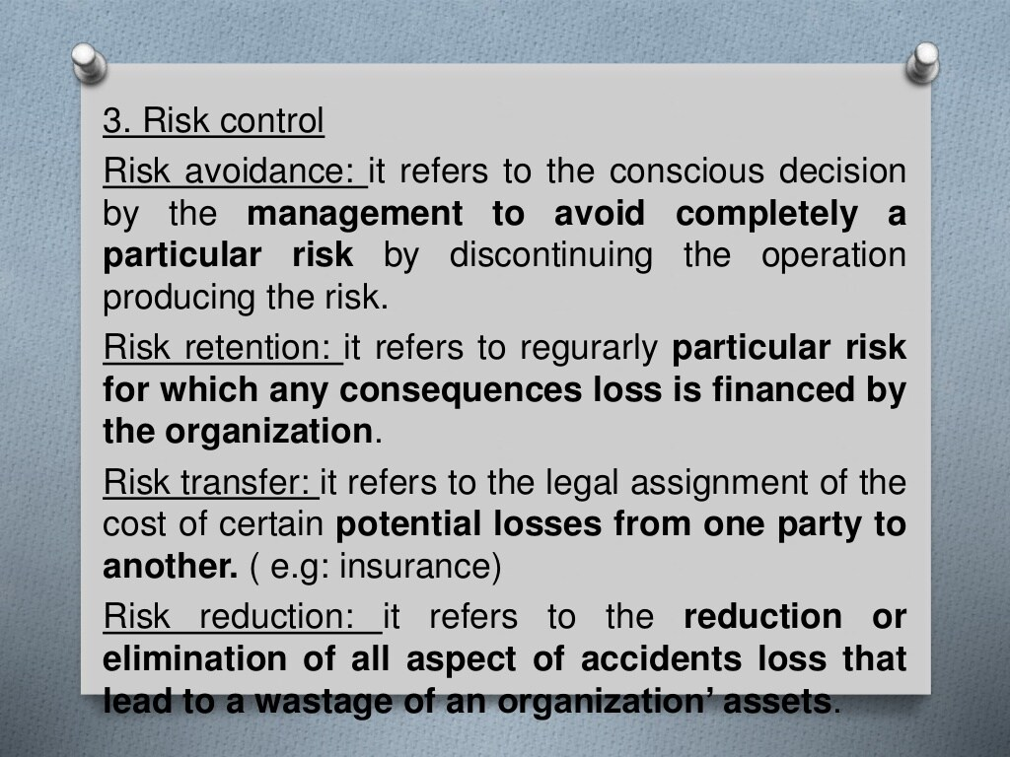

Slide 10
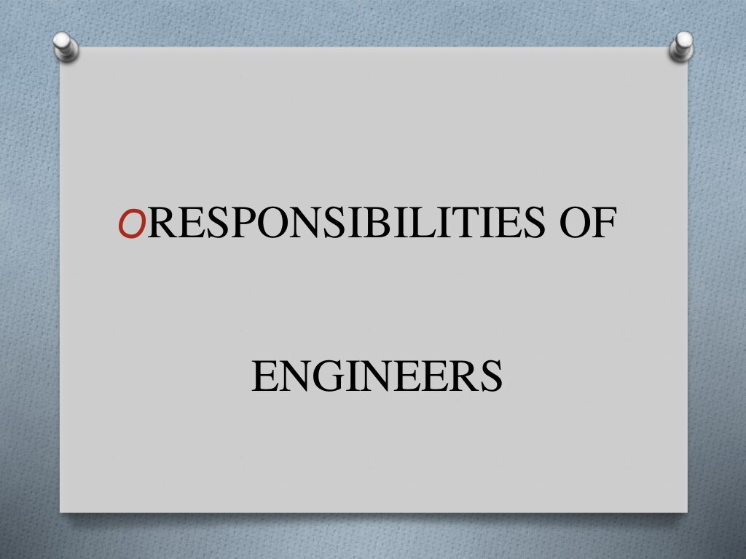

Slide 11
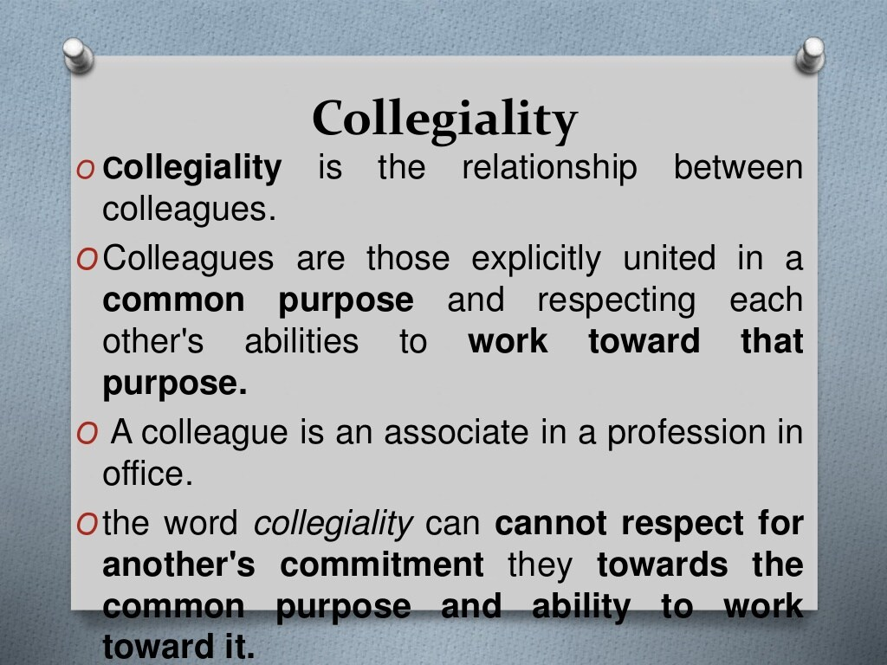

Slide 12
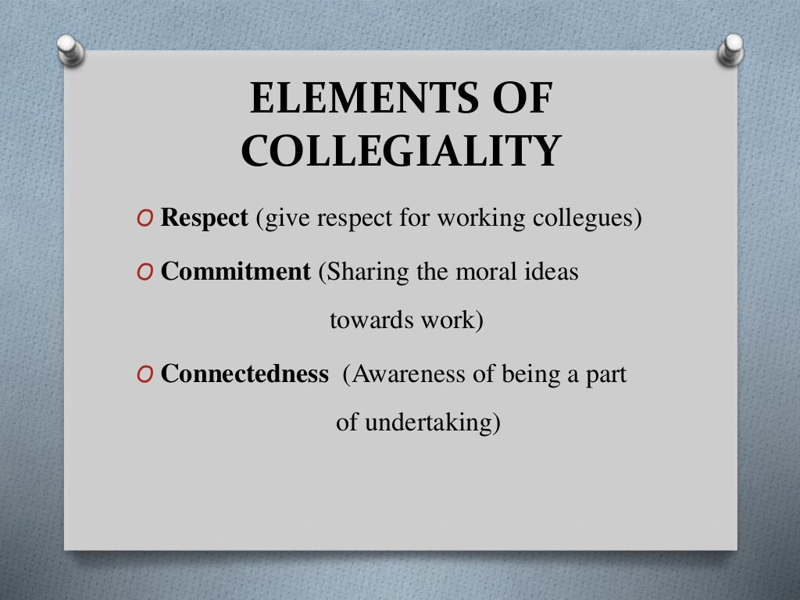

Slide 13
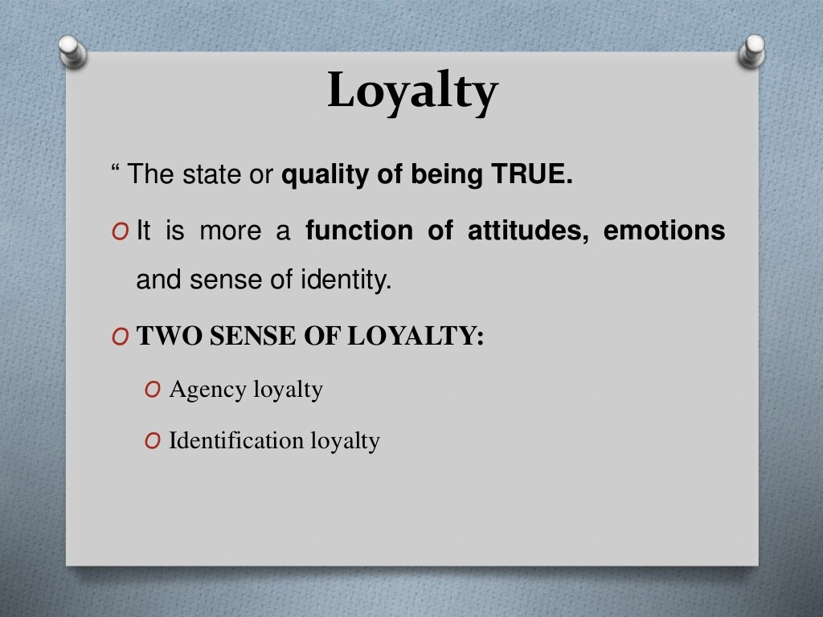

Slide 14
